Slide 1


Would
video become popular?

Slide 2
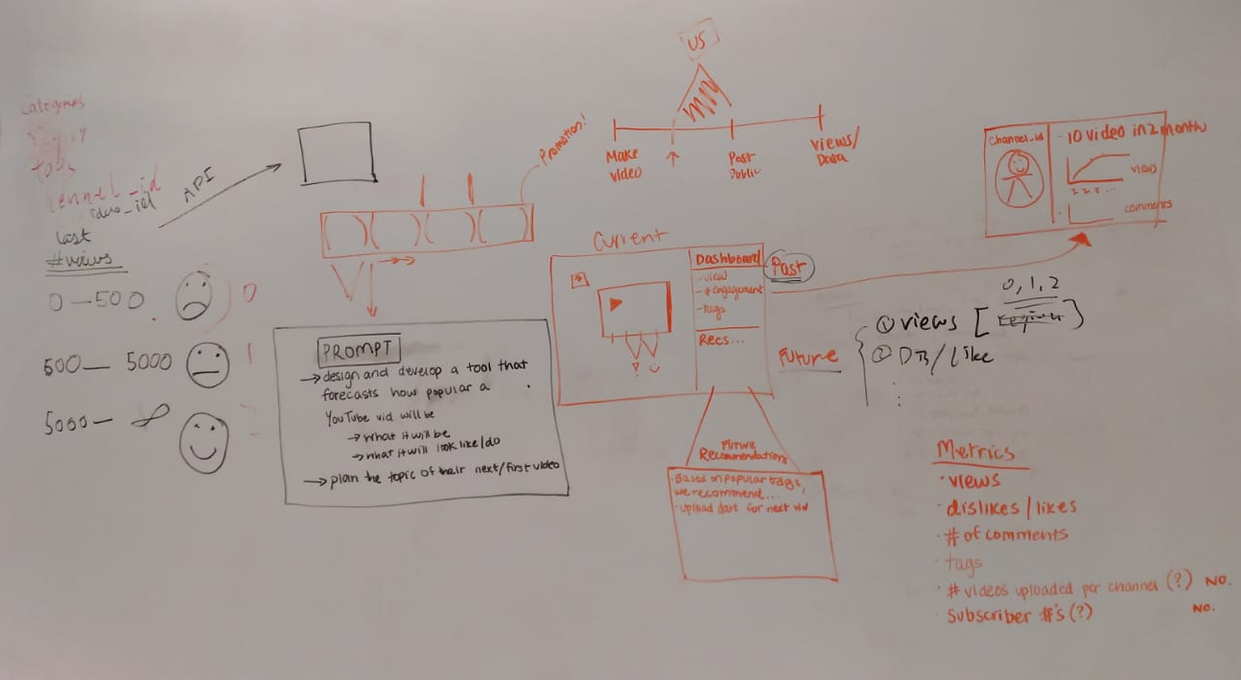

Slide 3




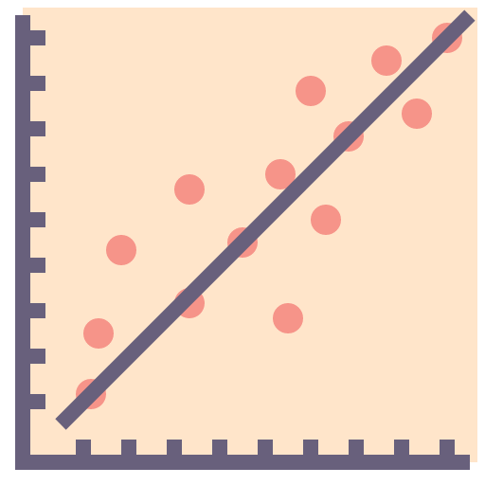





ML Model
Linear Regression
Class 1: 0 - 500
Class 2: 500 - 5000
Class 3: >= 5000
Previous Attributes About Youtube Content Creator
#likes / #dislikes ratio
Total #Views Previously Attained
Total #Comments
New Video Category
Category Information of New Video

Slide 4

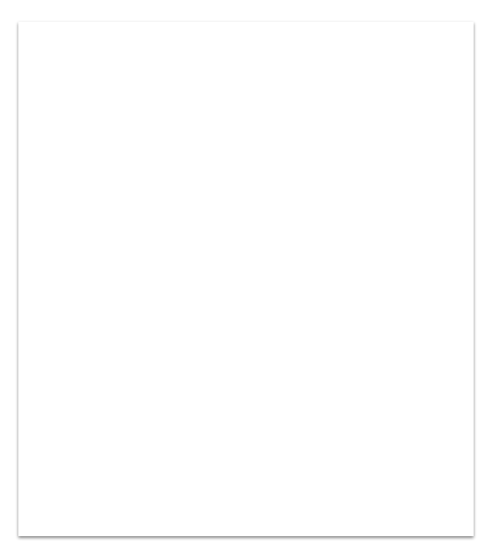

Future Works
Go Big! - In the Microservice Streaming based on events - Utilize Kafka + Spark Streaming + Dockerized Containers to provide seamless real-time feedback to users
Incorporate More Sophisticated Models - Time Series models like RNNs, LSTMS
Some more Exploratory Data Analysis - Eg: A/B Testing

